Slide 1
Soft Skills

Slide 2
INDEX
INTERPERSONAL COMMUNICATION
LISTENING
PERSUASION
NEGOTIATION
COMMUNICATING BAD NEWS AND GOOD NEWS/MESSAGES.
COMMUNICATING IN GLOBAL WORLD

Slide 3
1.
INTERPERSONAL COMMUNICATION

Slide 4
Communication
One of the most important interpersonal skills in any job is communication. Whether you work in IT, customer service, construction, or any other industry, you will need to be able to communicate clearly and effectively with others both verbally and in writing. Some jobs also require skills in effective public speaking.
Nonverbal communication
Public speaking
Verbal communication

Slide 5
Interpersonal skills are sometimes called employability skills.
The word “employability” is a tip-off about the importance of interpersonal skills: they’re so crucial that hiring managers really don’t want to hire candidates without them.
Many careers require consistent, if not constant, interaction with other people.
This is true even for jobs that would seem to favor introverted personalities and independent work styles.
For example, even if you’re a software engineer, writer, or statistician, you still need to be able to communicate and collaborate with your team.

Slide 6
COMMUNICATION
One of the most important interpersonal skills in any job is communication. Whether you work in IT, customer service, construction, or any other industry, you will need to be able to communicate clearly and effectively with others both verbally and in writing. Some jobs also require skills in effective public speaking.
Nonverbal communication
Public speaking
Verbal communication

Slide 7
CONFLICT MANAGEMENT
Whether you are a manager or an employee, you will likely need to resolve conflicts at some point in your job. This might involve solving an issue between two staff members, yourself and a colleague, or a client and your company. You will need to be able to listen fairly to both sides and use creative problem-solving to arrive at a solution.
Conflict resolution
Constructive criticism
Counseling
Mediating
Problem-solving

Slide 8
WHAT IS CONFLICT RESOLUTIONS
Conflict resolution is the process by which two or more parties reach a peaceful resolution to a dispute.
In the workplace, there can be a variety of types of conflict:
Conflict may occur between co-workers, supervisors, and subordinates, or between service providers and their clients or customers.
Conflict can also occur between groups, such as management and the labor force, or between entire departments.
Some conflicts are essentially arbitrary, meaning it doesn’t matter who “wins,” only that the problem is resolved so everyone can get back to work.
But some conflicts reflect real disagreements about how an organization should function.

Slide 9
An effort to understand the perspective and concerns of the opposing individual or group
Recognition by the parties involved that a problem exists.
Recognizing triggers to episodes of conflict.
A willingness by one or both parties to compromise.
Interventions by third parties such as human resources representatives or higher-level managers to mediate.
Identifying changes in attitude, behavior, and approaches to work by both sides that will lessen negative feelings.
Agreement on a plan to address differences.
Mutual agreement to address the issue and find some resolution.

Slide 10
Monitoring the impact of any agreements for change
Disciplining or terminating employees who resist efforts to defuse conflicts.

Slide 11
TYPES OF CONFLICT RESOLUTION

Slide 12
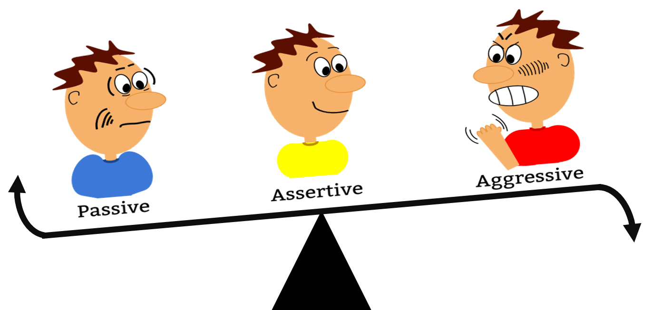
ASSERTIVENESS
A supervisor might take the initiative to convene a meeting between two employees who have engaged in a public dispute. An employee might seek out a person with whom they're having conflict to suggest working together to find ways to co-exist more peacefully.

Slide 13
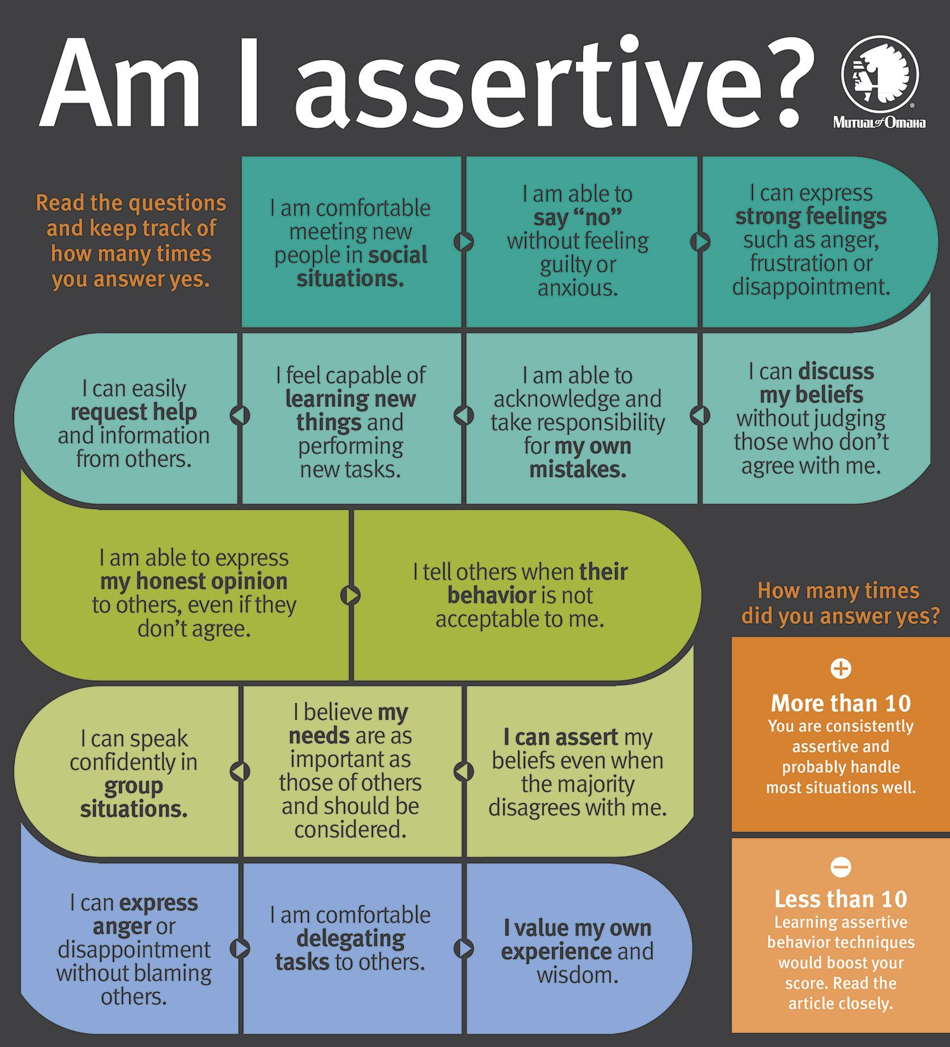

Slide 15
😉
😭

Slide 16
PARTS OF ASSERTIVENESS
Leadership
Managing Emotions
Management
Negotiation
Socializing
Voicing Opinions
Problem-Solving
Self-Control
Stress Management
Articulation
Balanced Approach
Candor
Decisiveness
Delegation
Fact-Based
Fairness
Firmness

Slide 17
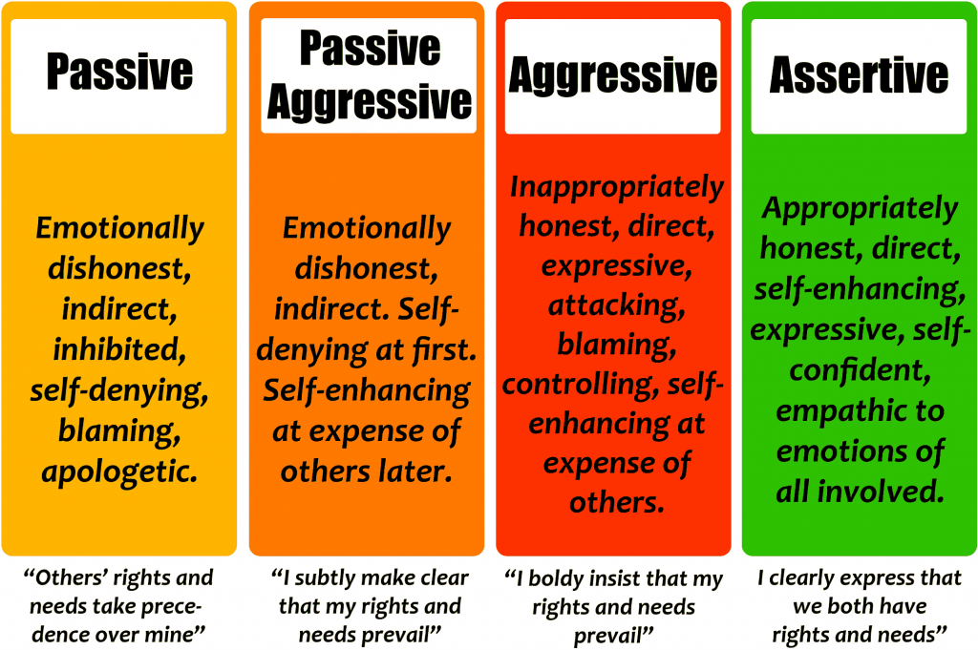

Slide 18
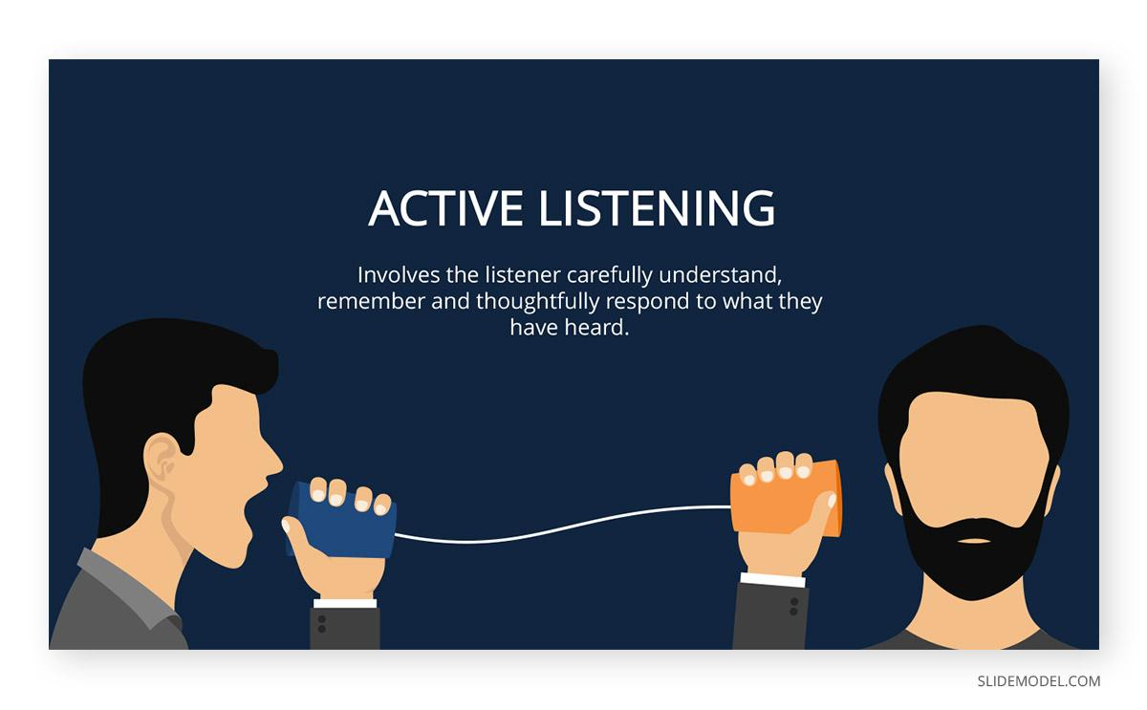
INTERVIEWING AND ACTIVE LISTENING
A human resources representative might have to ask questions and listen carefully to determine the nature of a conflict between a supervisor and a subordinate

Slide 19
INTERVIEWING AND ACTIVE LISTENING COMPRISES OF
Articulation
Attentiveness
Conscientiousness
Consideration
Empathy
Encouragement
Intuition
Listening
Negotiation
Respect
Sense of Humor
Sincerity
Socializing
Understanding
Verbal Communication
Nonverbal Communication
Persuasion
Prediction
Presentation
Professionalism
Relationship Building

Slide 20
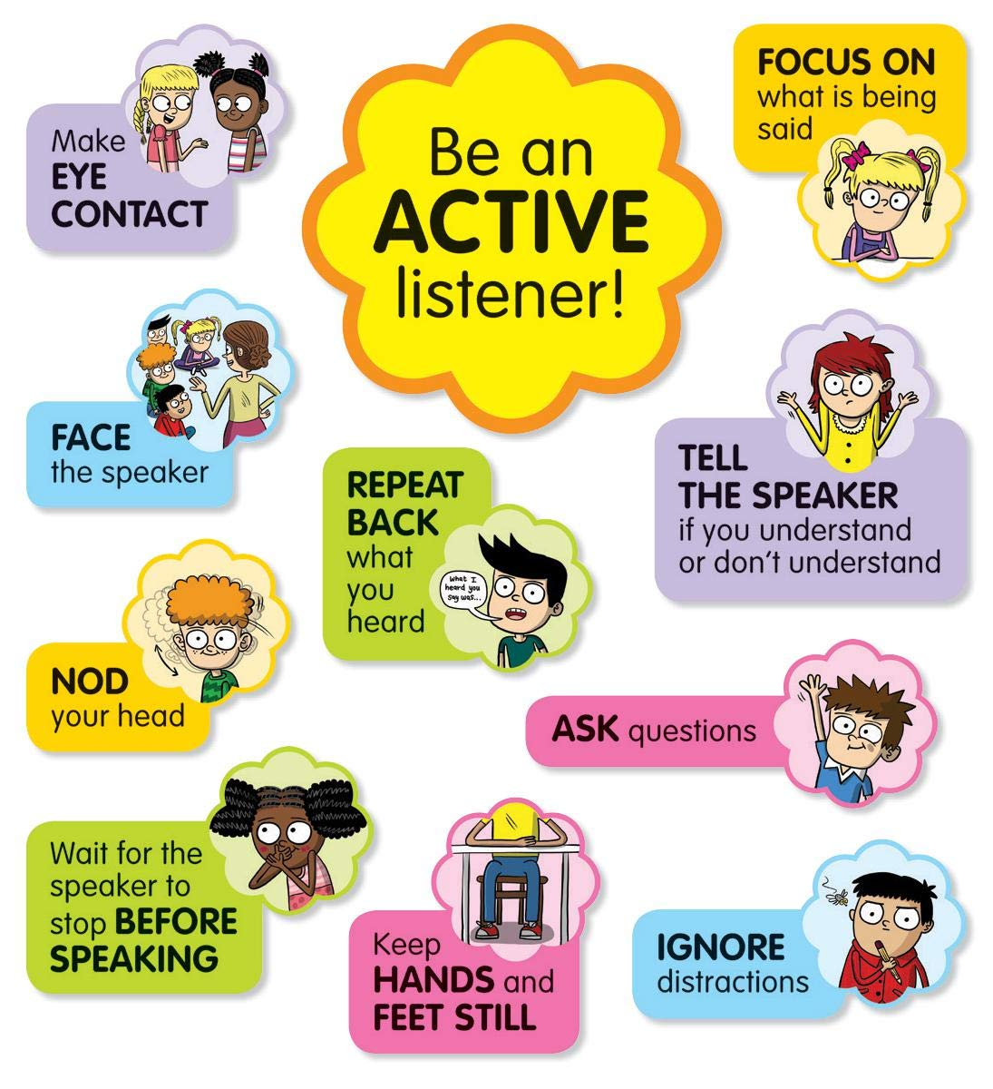

Slide 21
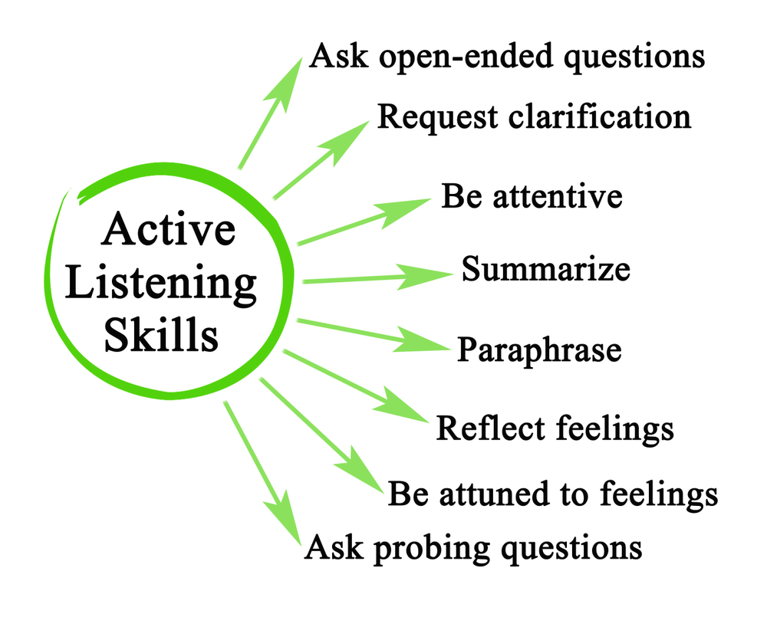

Slide 22
EMPATHY
A mediator might encourage empathy by asking employees in conflict to each describe how the other might be feeling and thinking, and how the situation might look to the other party.
Empathy is also an important skill for mediators, who must be able to understand each party’s perspective, without necessarily agreeing with either.

Slide 23
PRACTICES FOR EMPATHY
Asking for Feedback
Building Trust
Compassion
Inclusion
Giving Feedback
Handling Difficult Personalities
Managing Emotions
High Emotional Intelligence
Identifying Nonverbal Cues
Recognizing Differences
Understanding Different Viewpoints
Interpersonal skills
Patience
Personable
Self-Awareness
Self-Control
Trustworthiness
Welcoming Opinions

Slide 24
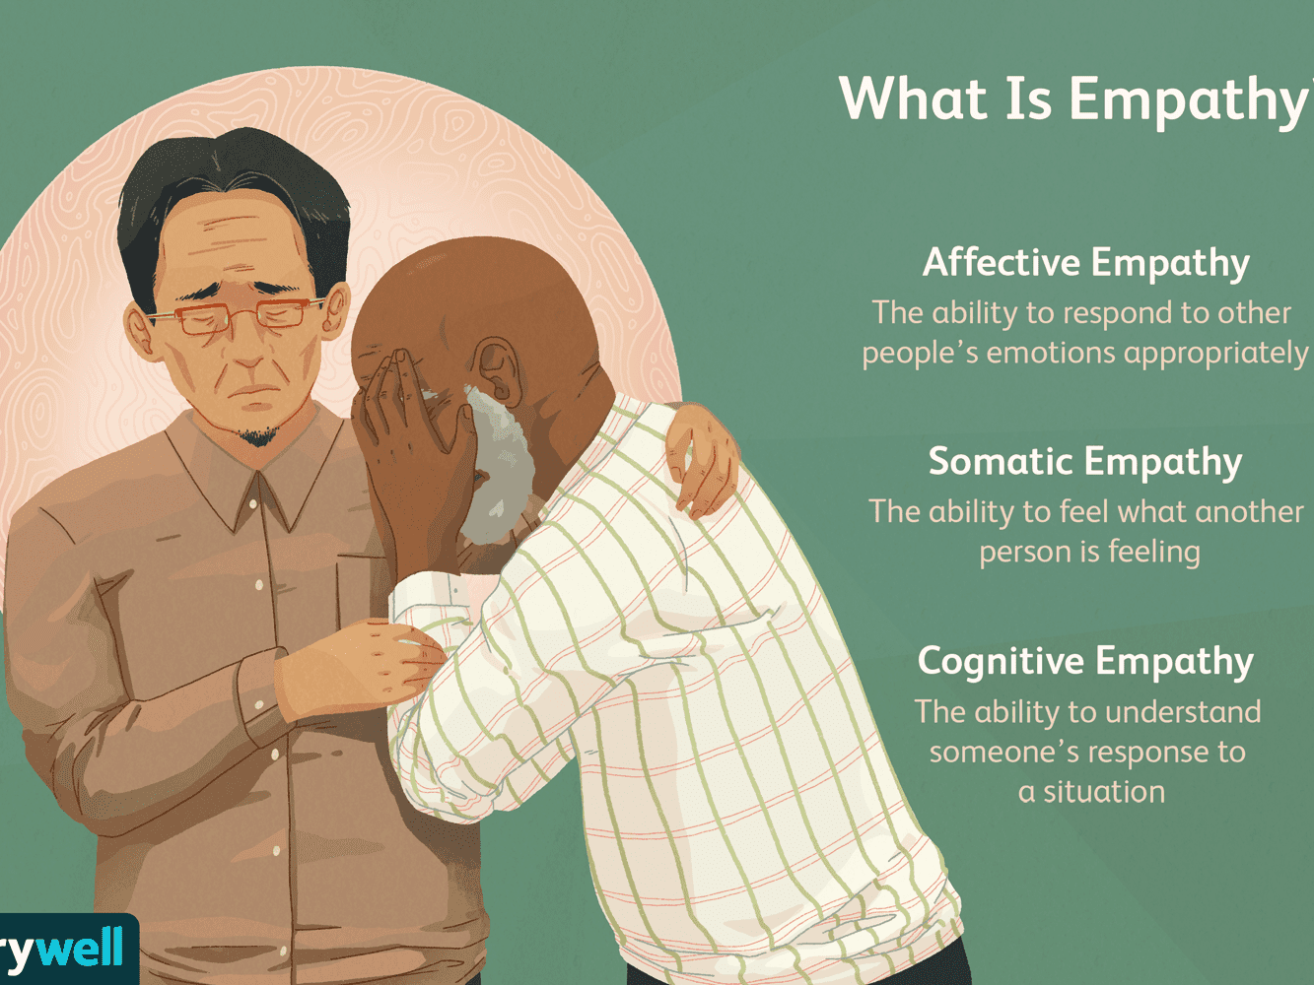

Slide 25
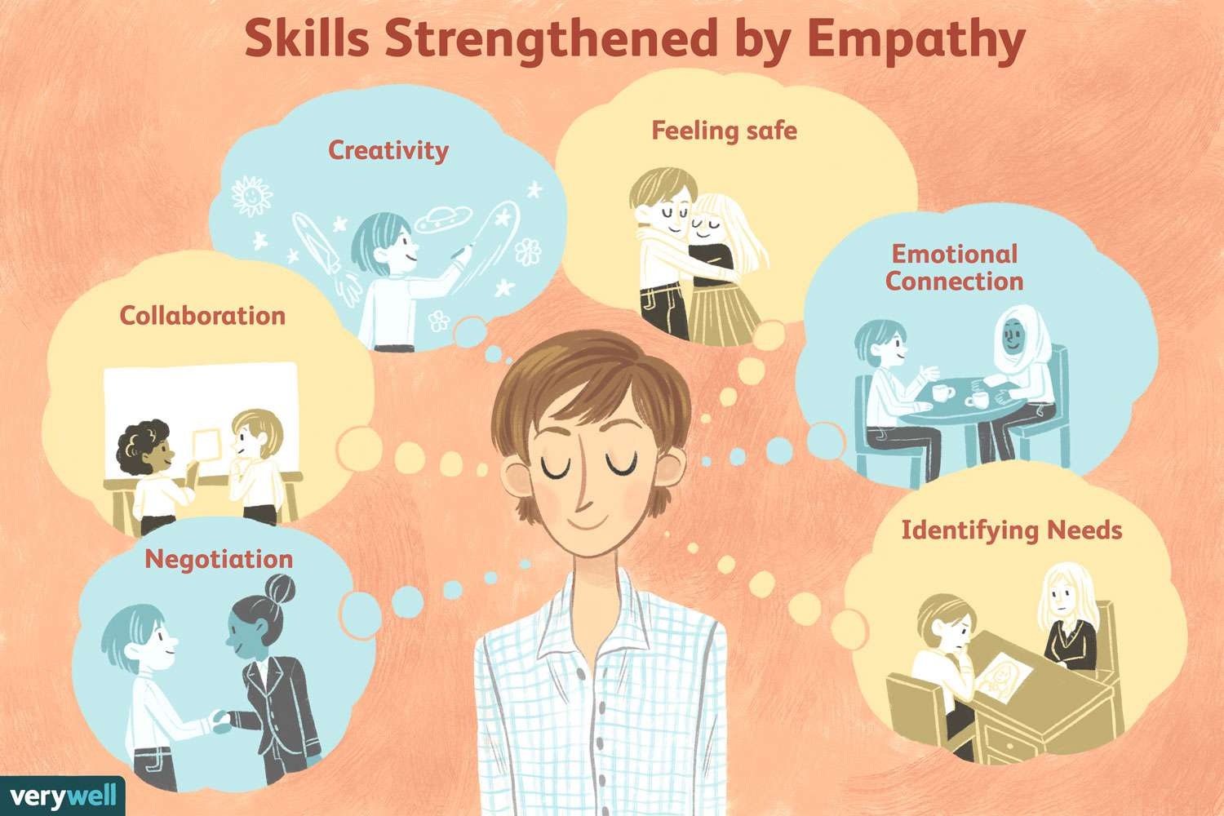
=

Slide 26
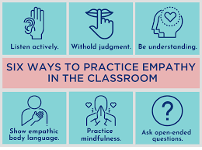

Slide 27
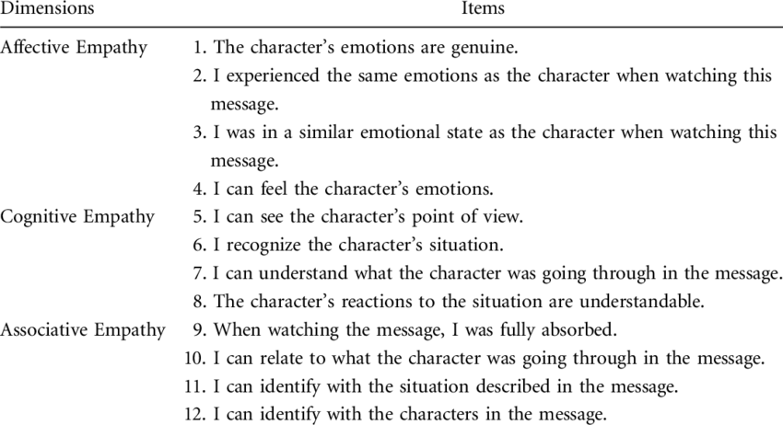
LET’S SEE HOW EMPATHETIC YOU ARE.
Answer in
YES
OR
NO

Slide 29
FACILITATION
Managers of rival departments might facilitate a joint brainstorming session with their teams to generate solutions to ongoing points of conflict.
Group facilitation techniques can also be used to avoid triggering conflict during group decision-making in the first place.

Slide 30
FACILITATION ALTOGETHER COMPRISES OF
Brainstorming
Collaboration
Conflict Management
Diplomacy
Ethics
Humility
Influence
Insight
Intuition
Listening
Organization
Patience
Perception
Planning
Practical
Realistic
Reflective
Teamwork

Slide 31
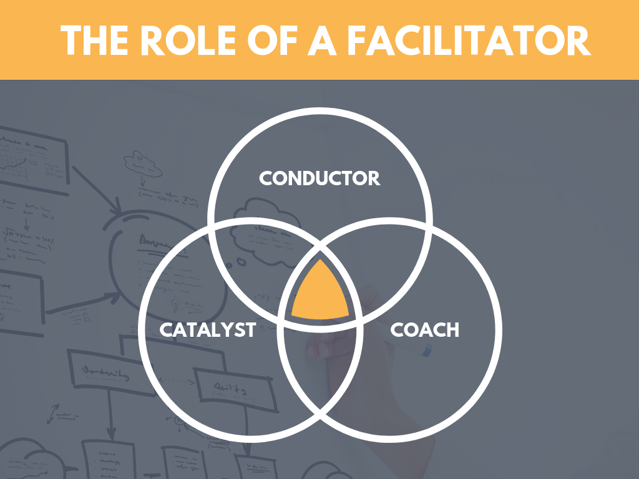

Slide 32
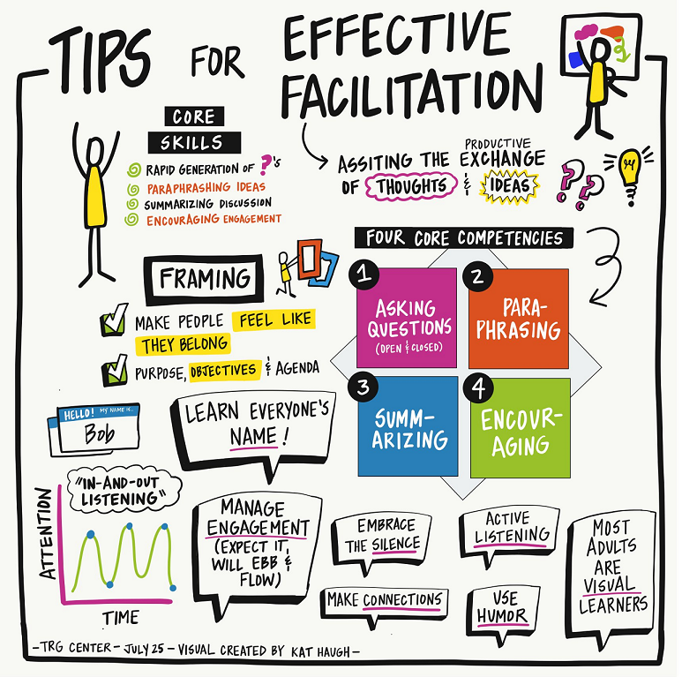

Slide 33

MEDITATION
A supervisor might guide subordinates who are in conflict through a process to identify mutually agreeable changes in behavior.

Slide 34
MEDITATION IS ABOUT PRACTICING
Assertiveness
Compassionate
Decision Making
Emotional Intelligence
Empathy
Honesty
Impartial
Insightful
Leadership
Measured
Patience
Problem Solving
Professionalism
Psychology
Rational Approach
Respect
Understanding
Transparency

Slide 36

PROBLEM SOLVING
A supervisor might redefine the roles of two conflict-prone staff to simply eliminate points of friction. Creativity can also mean finding new win/win solutions.

Slide 37
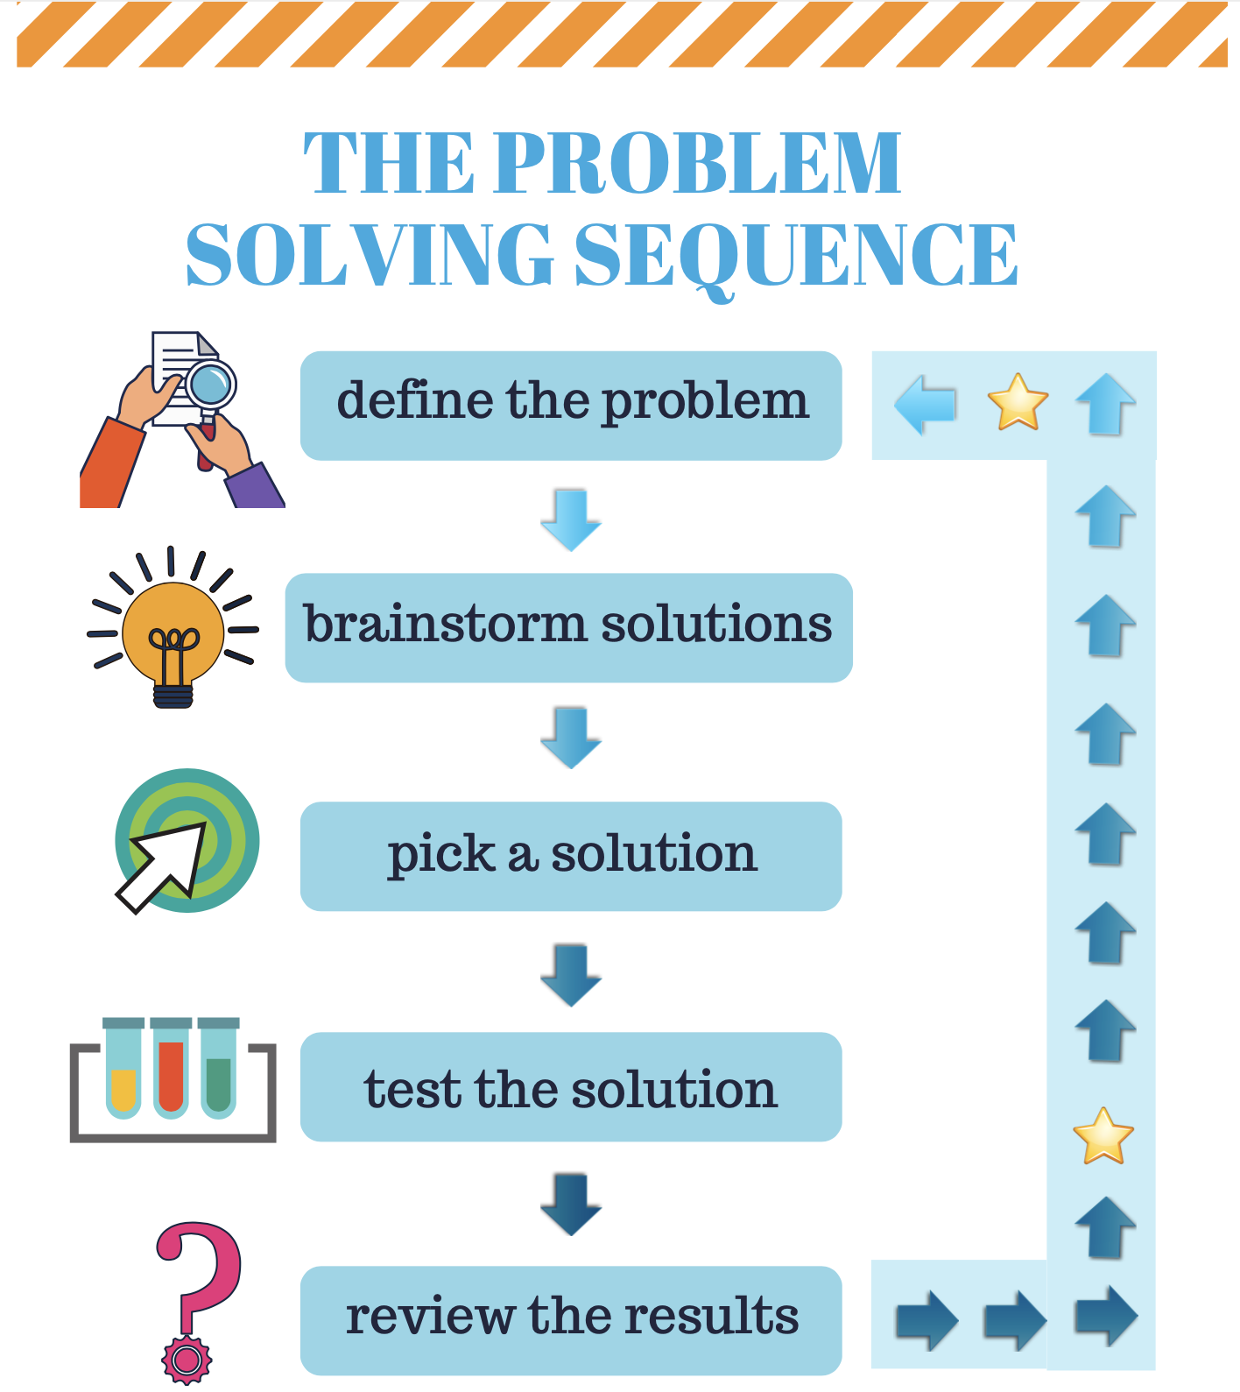

Slide 38
NEGOTIATION
Negotiation is an important skill for many positions. Depending on the specific job, it might involve creating formal agreements (or contracts) between clients or helping colleagues solve a problem and determine a solution. To be a good negotiator, you must be able to listen to others, use creative problem-solving, and arrive at an outcome that satisfies everyone.
Negotiating
Persuasion
Research

Slide 40
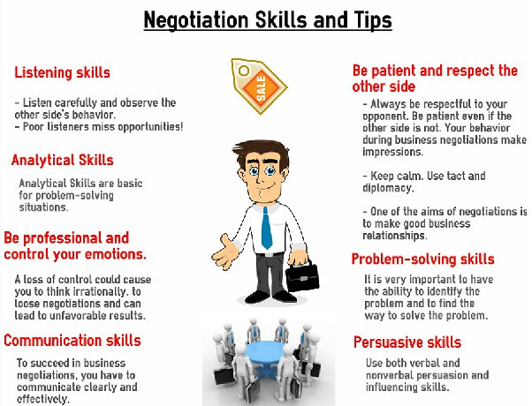

Slide 41
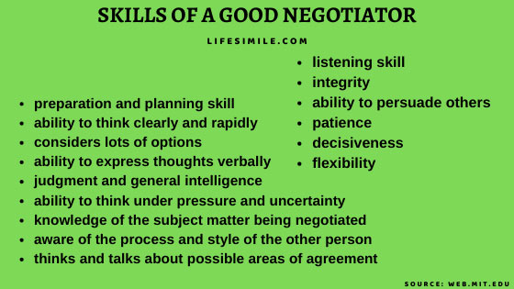

Slide 42
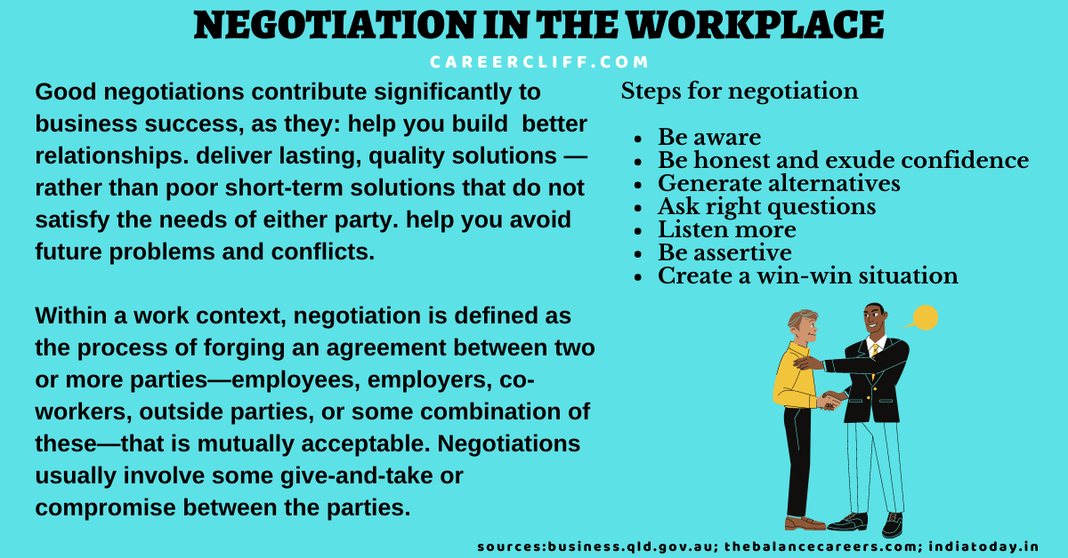

Slide 43
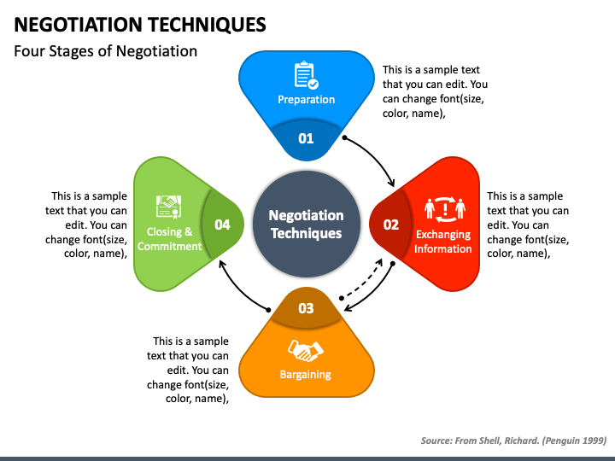

Slide 44
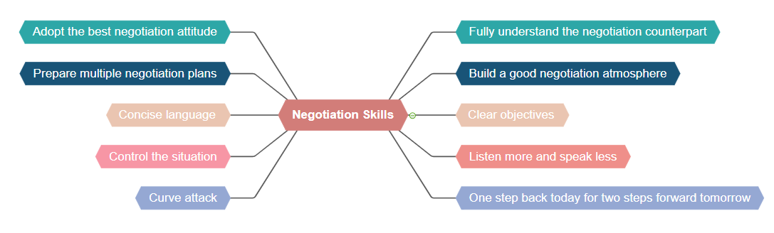

Slide 45
LEADERSHIP
Even if you are not a manager, it is important to have some leadership experience and ability. Leadership requires being able to motivate and encourage others and help a team achieve success.
Encouraging
Inspiring trust
Instructing
Management
Mentoring
Motivation
Positive reinforcement

Slide 46
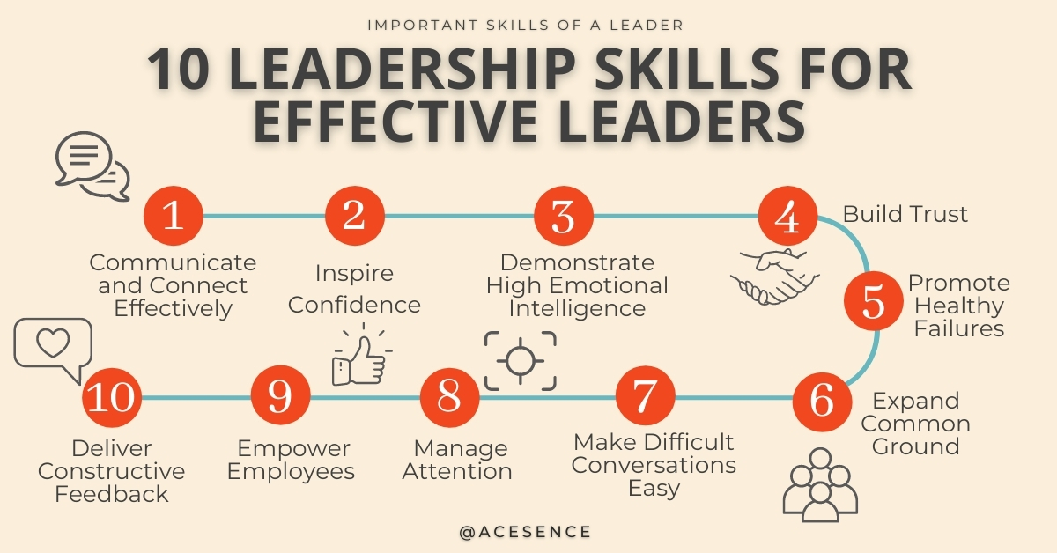

Slide 47
HOW TO IMPROVE YOUR LEADERSHIP SKILLS

Slide 48
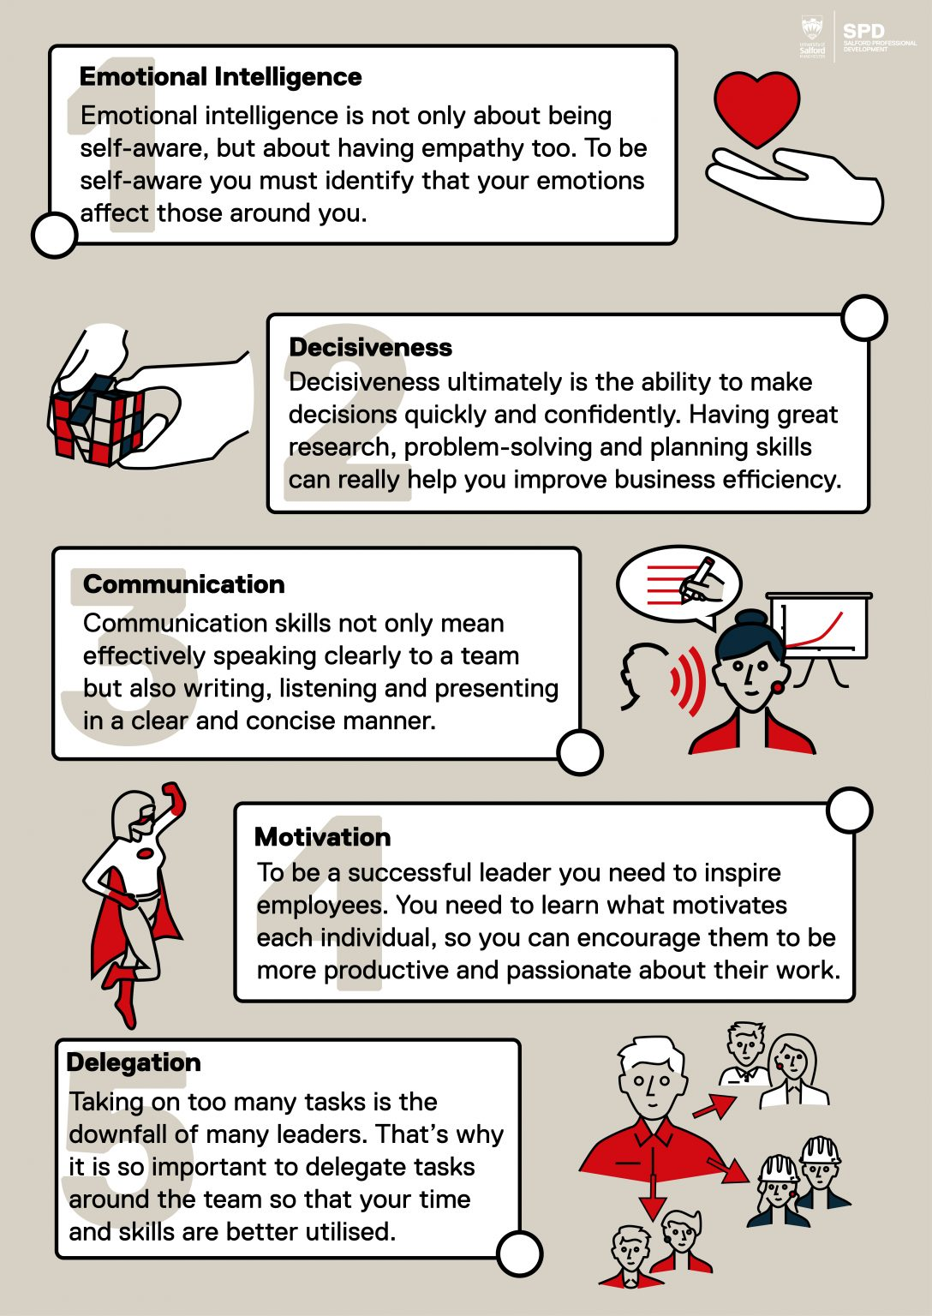

Slide 49
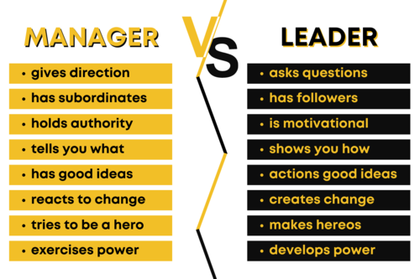

Slide 50
POSITIVE ATTITUDE
Employers want to hire employees who make the office a brighter place. They want people with a friendly, positive demeanor.
This doesn’t mean you have to be the most social person in the office, but you must be willing to develop some sort of a positive rapport with your colleagues.
Behavioral skills
Developing rapport
Friendliness
Humor
Networking
Social skills

Slide 51
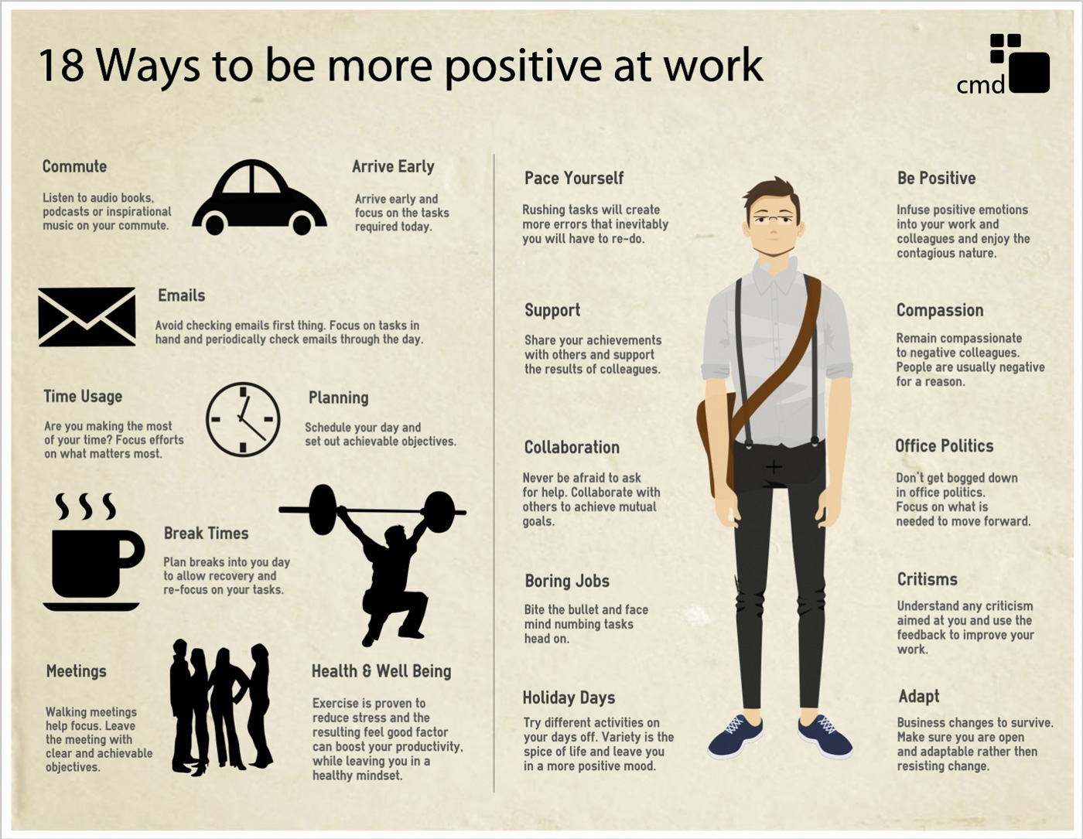

Slide 53
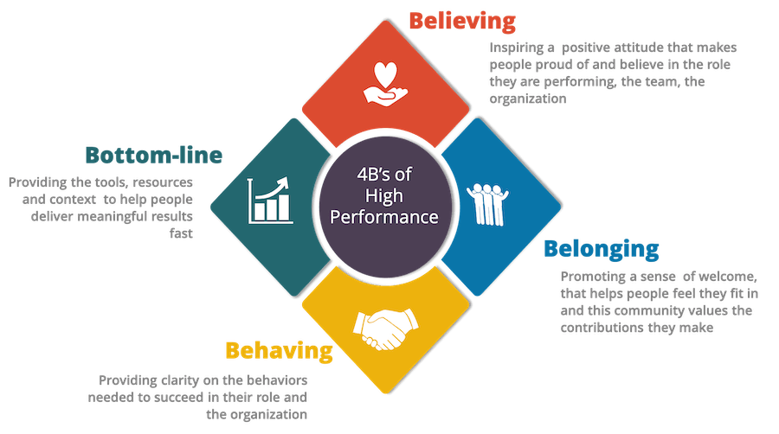

Slide 54
TEAMWORK
Even if your job involves a lot of independent work, you still need to be able to collaborate with others. Teamwork involves several of the skills already mentioned: you need to be able to listen to others, communicate your own goals, motivate your team, and resolve any conflicts that may arise.
Collaboration
Group facilitating
Team building
Teamwork

Slide 55
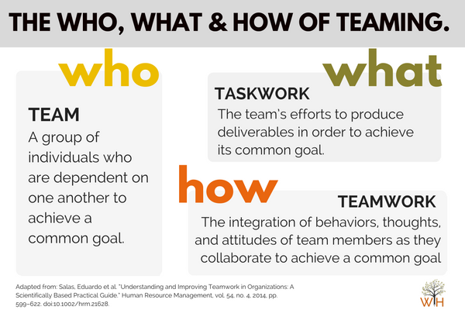

Slide 56
WHAT IS PERSUATION
Persuasion is the ability to influence other people's thoughts and opinions using convincing arguments and facts.
Persuasion skills are necessary to help individuals consider alternative points of view in professional situations.
The ability to persuade may prove beneficial in many job roles and business environments.

Slide 57
Persuasion is the process of convincing someone else to carry out an action or agree with an idea.
In the workplace, you may use persuasion to sell products, recruit team members and increase productivity.
Persuasion can be done through verbal or written communication using logical reasoning, data analysis and verifiable facts to prove that your point of view is feasible and has merit.

Slide 58
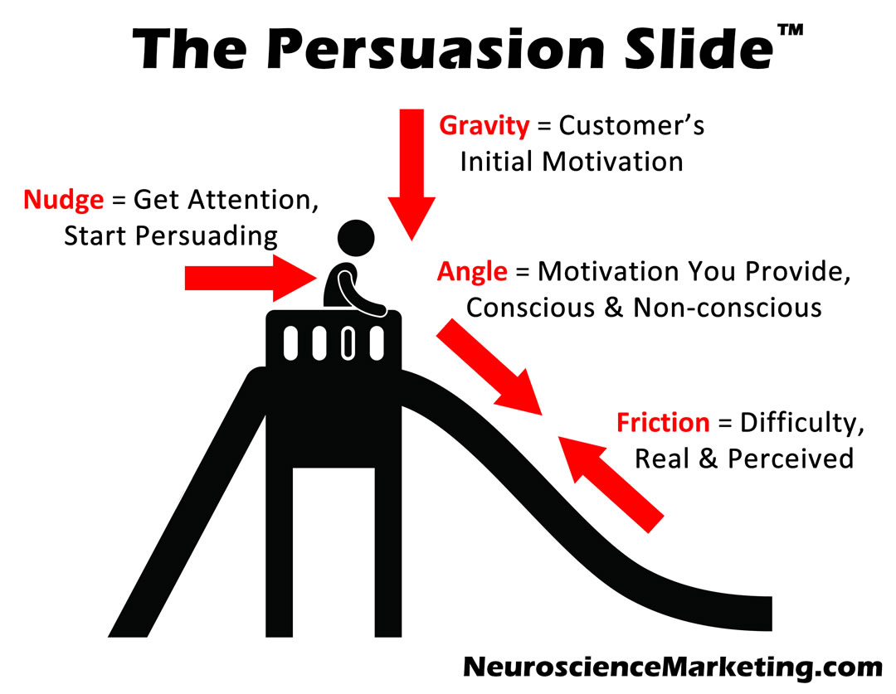

Slide 59
EXAMPLES OF PERSUATION
Written, visual and media advertisements are persuasive methods used by marketing professionals to influence a customer's purchase decision.
Large-scale campaigns for social causes like cancer awareness, sustainability and vaccination drives involve organized efforts to persuade diverse audiences. The persuaders may use one or more formats like posters, videos, public demonstrations, television advertisements and podcasts to subtly or explicitly promote ideas and concepts that they align with.

Slide 60
Speeches, articles and videos of motivational speakers are examples of their persuasion skills in action.
Salespeople use their persuasion skills to convert potential customers into loyal patrons of their brand.
Teachers, mentors and counsellors persuade students to engage well with their academic curriculum and make good career decisions.

Slide 61
Business owners and top executives may use persuasion during business deals and negotiations to safeguard their business interests.
Team managers use persuasion to motivate their team members to complete work on or ahead of schedule.

Slide 62
WHAT SKILLS DO YOU NEED TO PERSUADE OTHERS.
Persuasion skills can be a natural talent or personality trait. You can also develop and master this skill with adequate practice and determination. These skills help you convince someone to carry out an action or consider an idea.
Organizations often employ people with persuasion skills to sell products, get new clients, recruit new employees and increase productivity. A person with strong persuasion skills at their workplace can motivate and inspire colleagues to perform better and succeed at their work.

Slide 63
SKILLS REQUIRED
Communication skills
Emotional intelligence
Active listening skills
Logical reasoning ability
Interpersonal skills
Negotiation skills

Slide 64
COMMUNICATION
While sharing ideas, be engaging and use a tone that appeals to the listener.
List the positive features of your idea and refrain from demeaning theirs.
For example, if you are selling a product, talk extensively about how your product is better and sparingly about the shortcomings of the product they already own. Honoring and respecting a customer's purchasing decisions can help build trust.

Slide 65
Essentials for problem Solving
Brainstorming Solutions
Conflict Analysis
Collaborating
Creative Problem Solving
Critical Thinking
Convening Meetings
Creativity
Critical Thinking
Decision Making
Designating Sanctions
Fair Resolution
Goal Integration
Monitoring Process
Restoring Relationships
Sense of Humor
Verbal Communication
Nonverbal Communication
Problem Solving

Slide 66
EMOTIONAL INTELLIGENCE
When you are trying to persuade someone, evaluate their feelings and emotions before you speak.
With enough practice, you can respond to situations appropriately and customize your persuasion tactics according to the specific situation you are in.
While some individuals may appreciate a matter-of-fact attitude and concise arguments, this need not always be the case.
Some may demand a detailed explanation and may expect you to be more empathetic.

Slide 67
With emotional intelligence, you can gauge a person's mood and willingness to be persuaded and tailor your arguments accordingly.
For example, as a manager, you may choose a reassuring tone to communicate with a nervous employee and a firm, rational tone with someone who is engaging in conflict after receiving constructive feedback.
As you build emotional intelligence, you can be confident that you do not sound intimidating or patronizing to either of them.

Slide 68
USE [LR] TO SUPPORT YOUR ANSWERS
You can rely on logic, rational thought and verifiable facts in your argument to compel listeners to subscribe to your idea or viewpoint.
Gather comprehensive data and allow the other person enough time to examine the data, interpret it and come to conclusions.
Share examples and your analysis of similar situations that have happened in the past. F
or example, if you want to convince your manager about shifting to a new CRM (customer relationship management) tool, talk about its benefits in terms of financial, temporal and labour costs. Consider sharing testimonials and reviews from credible sources.

Slide 69
NEGOTIATION
Consider creating a list of all that you can offer, as well as your limitations. Once you have identified limitations, both parties can start working on a compromise.
By compromising a little yourself, you can persuade the other party to reciprocate. Instead of making huge compromises in one round, try to maintain leverage while negotiating.
Be prepared for multiple rounds of negotiation until you reach an arrangement that is beneficial for all parties.

Slide 70
THREE TYPES OF PERSUATION
LOGIC
ETHICS
EMOTIONS

Slide 71
LOGIC
When your arguments are based on logic and rationale, supported by relevant data, testimonials and evidence, it is considered a logical type of persuasion.
Support your argument with facts, evidence, historical data and logical reasoning.
When you use logic as a mode of persuasion, convey it in a way that makes sense to your listener.
Try to enable them to see through your logical framework, instead of criticizing their perspective or the logic that they may have applied.

Slide 72
ETHICS
If you are trusted by someone, you may be able to persuade them with ease. That is why improving your credibility is so important.
Your qualifications, experiences and reputation can contribute to your credibility.
In many instances, you may have to convince the listener that you are motivated by a cause and not by personal gain.
It may take years to build and maintain your credibility. Remember that any impulsive actions or irresponsible behavior can harm your reputation quickly.

Slide 73
EMOTION
When you sway listeners and persuade them by appealing to their feelings, it is called persuasion by emotion. While persuading using emotion, it is important to refrain from unethical manipulation.
During emotional persuasion, the persuader needs to take ownership and responsibility for the outcomes.
Hence, it is good practice to pre-visualise these aspects and consider all outcomes before proceeding.
Some avenues where emotional persuasion is used are political campaigns, fundraisers and religious congregations.

Slide 75
DELIVERING BAD MESSAGES
In business writing, a bad-news message is a letter, memo, or email that conveys negative or unpleasant information—information that is likely to disappoint, upset, or even anger a reader. It is also called an indirect message or a negative message.
Bad-news messages include rejections (in response to job applications, promotion requests, and the like), negative evaluations, and announcements of policy changes that don't benefit the reader.
A bad-news message conventionally begins with a neutral or positive buffer statement before introducing the negative or unpleasant information. This approach is called the indirect plan.

Slide 76
Sample: Rejection of a Grant Application
On behalf of the members of the Research & Scholarship Committee, thank you for submitting an application for this year's Research & Scholarship grants competition.
I’m sorry to report that your grant proposal was among those that were not approved for funding in the spring. With the reduction in grant funds caused by budget cuts and the record number of applications, I’m afraid that many worthwhile proposals could not be supported.
Although you did not receive a grant this year, I trust that you will continue to pursue both internal and external funding opportunities.

Slide 77
INTRODUCTION
(1) provide a buffer to cushion the bad news that will follow.
(2) let the receiver know what the message is about without stating the obvious.
(3) serve as a transition into the discussion of reasons without revealing the bad news or leading the receiver to expect good news.

Slide 78
BODY/EXPOSITION
State it clearly and concisely, and explain the reasons briefly and unemotionally.
Avoid apologies; they weaken your explanation or position.
Try to embed the bad news in a supporting, not the topical, sentence of a paragraph.
Try to embed it in a subordinate clause of a sentence. The purpose is not to conceal the bad news, but to soften its impact."

Slide 79
CONCLUSION
Avoid overused closings such as If you have any questions, please don't hesitate to call. ... Offer the receiver another option.
Presenting another option shifts the emphasis from the negative news to a positive solution."
The purpose of the closing is to maintain or rebuild goodwill. ... The closing should have a sincere tone
"The closing of a message containing negative news should be courteous and helpful.

Slide 80
DIRECT APPROACH
The direct approach is often used when the audience values brevity, the message needs to be concise,
The message is very complex and might not be understood easily,
The message is related to a known issue or problem (and bad news won’t be a surprise), or you’re terminating a business relationship.

Slide 81
DIRECT APPROACH EXAMPLE
Your request for vacation time from August 1-30 was not approved because it is over your vacation days entitlement of 10 days.
Please re-submit your request for vacation days (up to a maximum of 10) to HR as soon as possible.

Slide 82
INDIRECT APPROACH
When the bad news may have a significant impact on the recipient or you don’t know them very well, you may prefer to use the indirect approach.

Slide 83
INDIRECT EXAMPLE
Thank you for submitting your request for 10 days of vacation (your maximum entitlement) in August.
Summer is traditionally a time when many employees are out of the office and demands on the servers are reduced. In order to minimize the disruption to staff throughout the company, the IT department will be rolling out a server replacement project during July and August. Because this project will need to be completed in a more compressed timeframe, no vacation requests in July and August are possible for staff in the IT department. As a result, your request for vacation during August has not been approved. However, you are welcome to take vacation before and/or after the project rolls out. In compensation, HR is providing IT staff with three extra days of paid vacation.
We look forward to receiving your revised vacation request soon.

Slide 84
BUFFER STATEMENT
The first part of a negative news message, verbal or written, is a buffer statement. It provides neutral or positive information.
It sets the tone and often serves as a cushion for the information to come.
It is important that the buffer not be overly positive because this can be misleading or set up the reader to expect a positive news message instead.

Slide 85
EXPLINATION
Next, an explanation discusses why there is an issue. This may be relatively simple, quite complex, or uncomfortable.
While an explanation is important, never admit or imply responsibility without written authorization from your company cleared by legal counsel.

Slide 86
BREAK THE BAD NEWS
The third part of the negative news message involves the bad news itself, and the emphasis here is on clarity and accuracy.
While you want to break the bad news clearly, try not to spotlight it.

Slide 87
REDIRECT OR PROVIDE ALTERNATIVES
The fourth part of a bad news message is the redirect, where you refocus attention on a solution strategy, possible alternatives, or the subsequent actions that will take place.

Slide 88
END POLITELY AND FORWARD LOOKING
Last, you want to end your message politely and look to the future. Don’t mention the bad news again!

Slide 89
GOOD NEWS MESSAGE
A Good News Message is a message, which contains positive news and receives an efficient response from the reader. Commonly, delivering these messages is very convenient because they contain objectives that offer comfort to a reader and leave a pleasant thought. While on the other hand, writing good news messages is also not a hard task, as it informs the reader about beneficial information.

Slide 90
THANK YOU MESSAGES
In these types of good news messages a message should be written in the form of Thank-You because it is sure to receive positive response as well as it is good for strengthening relation. Follow the structure and let the receiver feel important, as:
Start with a good news
Give additional information regarding what the receiver did that you are appreciating
End with such compliments that leave an impact on the receiver

Slide 91
CONGRATULATORY MESSAGES
Let thing happen which is unexpected. Commonly, Congratulation Messages make a quick impression on the reader and create goodwill. The reader may not be sure to receive congrats, so this will surely earn extra points.
Offer Congrats for a particular achievement
Show your sincerity by providing a few details
Make an impact on the receiver with a good end

Slide 92
RECOMMENDATION MESSAGE
These types of good news messages should be written with a good news strategy. Starting with an excellent introduction and ending with effective words might be enough to achieve a target.
Introduce the candidate/job or its benefit.
Mention facts related to the position.
Offer to provide additional information and close the message.

Slide 93
GOODWILL
The actual purpose of writing a goodwill message is to form an excellent personal relation with the reader and the reader should feel the importance of this message.
The goodwill message requires to be written according to professional way.
To a business enthusiast, having enough knowledge about good news messages possesses huge importance, because delivering a good news message according to appropriate way may build an effective relation with the reader.

Slide 94
For encouraging the receiver to keep doing good work
To appreciate the efforts of an employee
Thanking supplier for receiving special services
For having long-term support and productive relationship
For saying thanks to the speaker
For accepting donations sent by the writer

Slide 95

COMMUNICATING IN GLOBAL WORLD

Slide 96
Understand that each country has different business customs
Recognize that you are communicating with actual people
Communicate through phone or video conference
Keep others copied
Show interest

Slide 97

UNDERSTAND

Slide 98
Understand that each country has different business customs
In a world as vast as ours, there are bound to be differences. Some of these differences are obvious like language barriers. However, many are much more subtle.
In Japan, it is rude to say “No” even in business.
So, if you are in communication with a colleague in Japan, don’t be surprised if you feel like the conversation drags on.
Also, don’t try to put an abrupt end to a conversation. This will be seen as impolite.

Slide 99
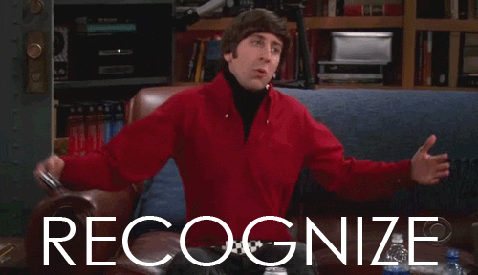
RECOGNIZE

Slide 100
Recognize that you are communicating with actual people
At times, communicating by email can sometimes feel like you’re interacting with a computer screen rather than a human being.
This can lead to unrealistic expectations. It helps to recognize that you are communicating with actual people just like you.
They may need reminders. They also have their own list of personal responsibilities.
There have been times when I was working on a critical project with an overseas colleague and I expected an overnight reply to an email.

Slide 101

COMMUNICATE

Slide 102
Communicate through phone or video conference
Putting a face or even a voice to the names of your global colleagues can do wonders.
It builds a stronger work relationship and allows you to get to know them on a more personable level.

Slide 103

KEEP OTHERS COPIED

Slide 104
KEEP OTHERS COPIED
Many things can get lost in translation, especially if you’re just starting to work with someone globally.
Keeping your manager or colleagues in your home country or office copied on the correspondence can help, especially when you do not completely understand something.

Slide 105

SHOW INTEREST

Slide 106
SHOW INTEREST
If you are just starting to work globally you will likely learn a lot more about other countries simply through your work. However, take some time to research countries that you work with regularly. Having a better understanding of even the weather in a country you work with can often give you more insight into the country.
Getting to know global regions beyond your work interest can also provide opportunities to get to know your colleagues in a more personal way.
E.G.[I enjoyed talking about skiing and snowboarding with colleagues in Sweden. I thought traffic and commuting were bad here in the U.S.]

